Slide 1
Optimising Developing Heart Growth Problem
Hashem Yousefi

Slide 2
Outline
Update on work done in the previous week
Issues which are not resolved
Action items from the other aspects
Plans for the following week
Submitting to the EMAC proceeding

Slide 3
Last Week
Checking other optimization methods (SNOPT, ALHSO) in the pyOpt Module
Plotting the objective function for a simple 2-D case …
Reading the mesh
Following up on a report for the Mesh Painting section
Notification of acceptance received from EMAC

Slide 4
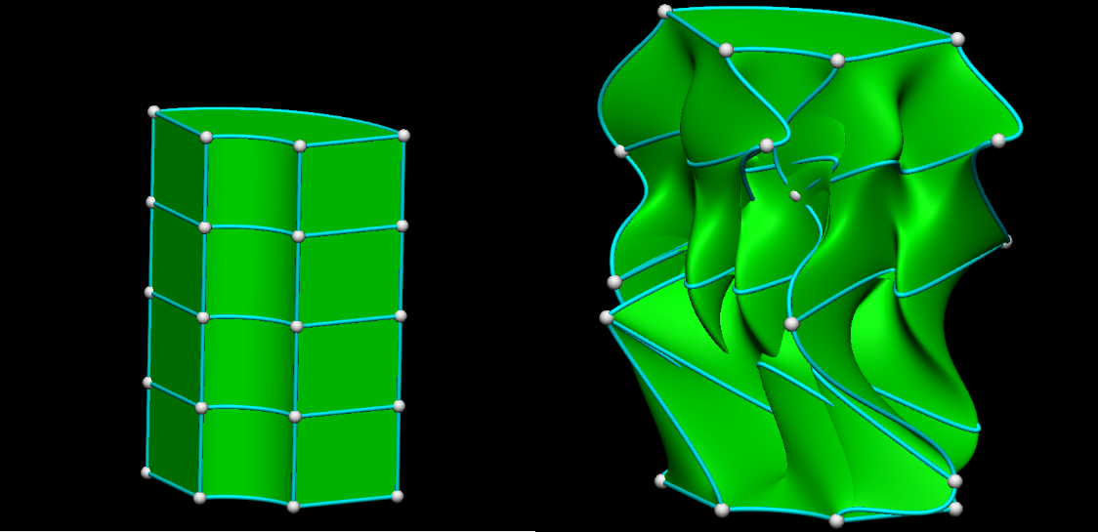
Problems tried many times on B.Cs. but all failed

Slide 5
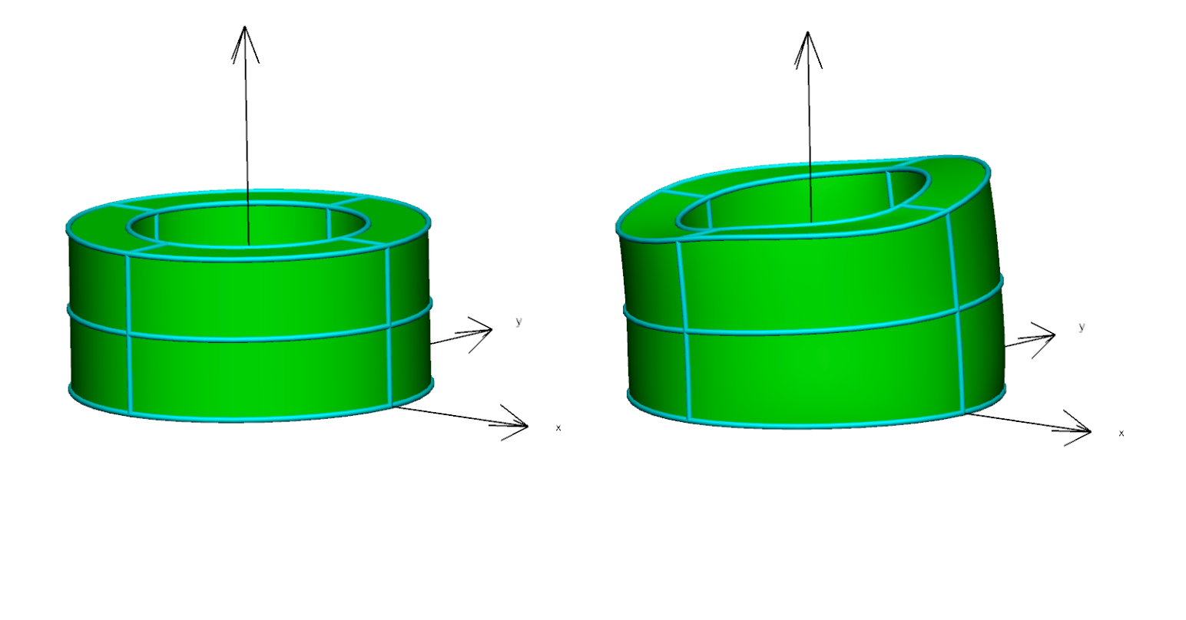
Forward Problem for 8 Elements to Test 12 Growth Rates with ALHSO
form of final answer
Fibre , sheet, normal
[0.0065, 0.025, 0.0001, 0.0045, 0.015, 0.0001, 0.0025, 0.005, 0.0001, 0.0045, 0.015, 0.0001]

Slide 6
Optimisers
Name | SLSQP | NSGA2 | NSGA2 + SLSQP | NLPQLP & SNOPT | ALPSO | ALHSO | MIDACO
Problem | 1 Elements 2 Elements 8 Elements | 8 Elements20x20 8 Elements20x40 | 8 Elements (20Gen-20size) 8 Elements (20Gen-40size) | ------- | 1 Elements 2 Elements 8 Elements | 8 Elements-hms5 8 Elements-hms15 | 8 Elements
Time | 1-2 hours 1-2 hours 1-2 hours | 5 hours 11 hours | 6 hours 17 hours With not a good initial condition | -------- | 2hours 1.2 hrs ,2.5-5 hrs 72hrs, 10hrs, 6hrs, 20hrs | 8 hours 9 hours Both stopped before SLSQP | Stopped
Min Obj Value | 0.000064 0.17 0.29- 0.38-1.0 | 0.22 0.1 | 0.17 0.04 | -------- | 0.61 (size40) 0.19 (5),0.10(40) 0.85(10), 0.1 (15), 0.29(30), -(60) | 0.36 (500 calls) 0.17 (600 calls) | Answers are far away from what expected

Slide 7
Next Week Plans
+ Reading the derivatives ,,, (checking if the mesh is fine)
+Trying to import a mesh two meshes and provide the differences of them as the objective
+ Writing a report for the pros and cons of the optimizers
+ Finding how to apply parallelisation
+ complete the report by Monday

